Slide 1
Bio-Inspired High Speed Gaze-Tracking using a Dynamic Vision Sensor

Slide 2
Project Context
New & exciting field
Flexibility in approach
Never been applied before to gaze-tracking
Potential for extremely fast gaze tracking
>300Hz (conservative estimate)
~100kHz (in theory)
Are there eye movements we haven’t observed yet?

Slide 3
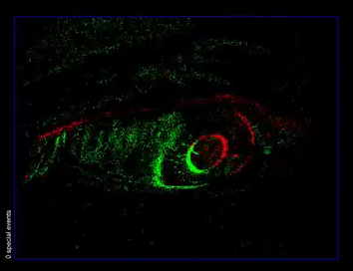
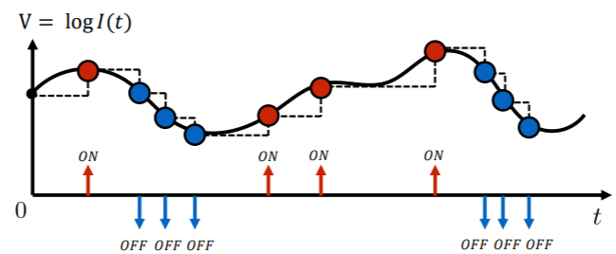
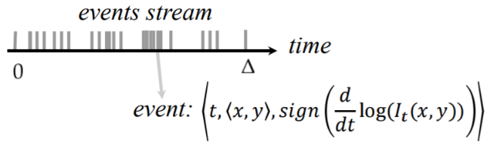
Dynamic Vision Sensors (DVS)
Lichtsteiner P, Posch C and Delbruck T. A 128× 128 120 dB 15 μs latency asynchronous temporal contrast vision sensor. IEEE; 2008.
Scaramuzza D. Tutorial on Event-based Vision for High-Speed Robotics. Lecture presented at; 2017; Robotics and Perception Group, University of Zurich
Notes:
Very similar to retina!

Slide 4
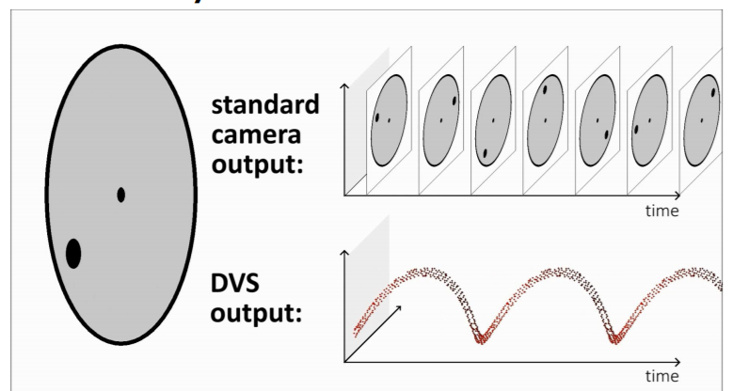
DVS Advantages over Frame-based Video
High speed (~ 1 microsecond latency)
Ignores redundant information (low bandwidth)
Robust to different illumination conditions (high-dynamic range)
ON/OFF: Implies direction of motion
Scaramuzza D. Tutorial on Event-based Vision for High-Speed Robotics. Lecture presented at; 2017; Robotics and Perception Group, University of Zurich
Notes:
Key pts:
WHY AM I DOING THIS PROJECT?
High speed: how frame-based works -> lost info. DVS asynchronous so events at exact time. Events on order of microseconds
Redund
PUT EXAMPLE OF DVS DATA VS TIME

Slide 5
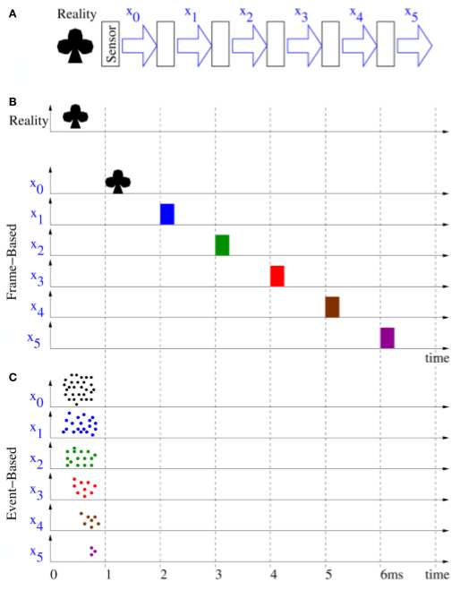
Processing DVS data
Two Methods for Processing:
Frame-based (synchronous)
Sequential image processing
Slow!
Event-based (asynchronous)
Operate on events as they come
Leverage advantages of DVS!
Mirrors biology
Farabet C, Paz R, Pérez-Carrasco J, Zamarreño-Ramos C, Linares-Barranco A, Lecun Y, et al.. Comparison between frame-constrained fix-pixel-value and frame-free spiking-dynamic-pixel convNets for visual processing. Front. Neurosci. 2012; 6:32.
Notes:
Frame-based:
Count events for each pixel during time window -> frame
Waste a lot of time waiting/idle
Use conventional image processing algorithms
Synchronous i.e. frame propagates thru pipeline sequentially -> SLOW
Result: low fps (bad for gaze-tracking!)
Event-based:
Ideally want to use events as they come!
Asynchronous i.e. events propagate in parallel along pipeline indep.
Allows rapid processing/inference
V similar to biology -> VC

Slide 6
Taking Inspiration from Biology
DVS output similar to retina
Visual system performs rapid processing of retinal ‘data’
Asynchronous & massively parallel
Spike timings (i.e. events) crucial for learning
Feedforward
ANNs mirror biological architecture but not firing mechanism
Spiking Neural Networks (SNN) include firing
Ideal for event data!
Guyonneau R, VanRullen R and Thorpe SJ. Temporal codes and sparse representations: A key to understanding rapid processing in the visual system. Journal of Physiology - Paris. 2004; 98 (4): 487-497.
Maass W. Networks of spiking neurons: The third generation of neural network models. Neural Networks. 1997; 10 (9): 1659-1671.
Notes:
A lot of req match with those of visual sys
Vis sys rapid (100ms):
Asynchronous: doesn’t need to ‘wait’ for retinal data, process const stream
Parallel: each neuron performs computations simultaneously.
Feedforward: time constraints (100ms)
ANNs:
Composed of ‘neurons’ and ‘synapses’
Continuous output doesn’t capture temporal component

Slide 7
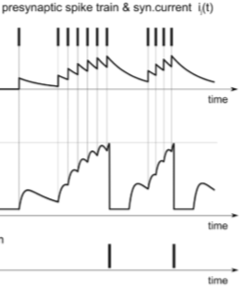

Spiking Neural Networks
Spikes modelled as Dirac-delta functions
LIF Neurons used for temporal tasks
Leak allows neurons to ‘forget’ previous inputs
Training to learn synaptic weights
Unsupervised
Supervised (more difficult)
Ponulak F, Kasinski A. Introduction to spiking neural networks: Information processing, learning and applications. Acta neurobiologiae experimentalis. 2011; 71 (4): 409.
Notes:
Similarity to ANN is topology, in layers
Difference is spikes vs continuous activation values
Dirac simplicity
Use LIF – describe eqn (ij is synaptic current)
Describe figure
Spikes @ presyn
LP filter
Integrated & added to memb pot
Thresh -> spike
Reset & hold (refractory period)
Two methods of training (labelled & unlabelled)
Spikes non diff -> cant use backprop
Gonna talk about a couple of uses of SNNs on DVS data

Slide 8
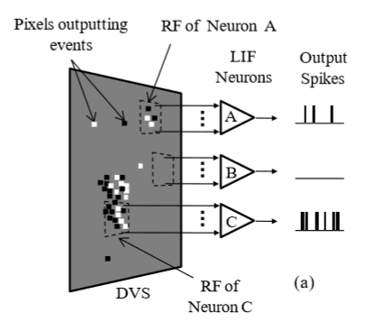
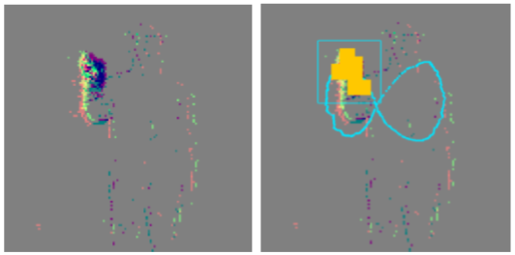
SNN for Gesture Recognition
Single layer of LIF neurons
LIF detect spatiotemporally correlated events
Detects ‘active’ regions
Firing LIF are clustered
Detects movement i.e. hands
No training required
Major assumption: majority of events are generated due to hand movement
J. Lee, T. Delbruck, P. K. J. Park, M. Pfeiffer, C.-W. Shin, H. Ryu, B.-C. Kang, "Live demonstration: Gesture-based remote control using stereo pair of dynamic vision sensors", 2012 IEEE International Symposium on Circuits and Systems (ISCAS), pp. 741-745, 2012.

Slide 9
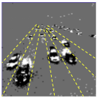
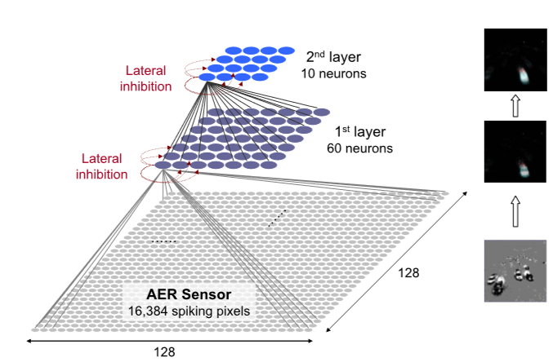
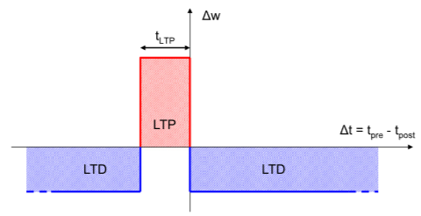
SNN for AER Car Tracking
2 layer feedforward SNN for feature extraction
Unsupervised training using STDP
Lateral Inhibition & Refractory Period
SVM classifier achieves 98% accuracy on trained features
Bichler O, Querlioz D, Thorpe SJ, Bourgoin J and Gamrat C. Extraction of temporally correlated features from dynamic vision sensors with spike-timing-dependent plasticity. Neural Networks. 2012; 32 339-348.
Notes:
Describe DVS input
Feature extraction, requires classifier after
STDP is biological mechanism – if correlation between firing@synapse and output spike, inc weight – reinforces frequent pathways
Lateral inhibition ensures only 1 neuron fires at a time -> learn diff features!
Describe architecture
10 mins of footage
Problem: requires classifier

Slide 10

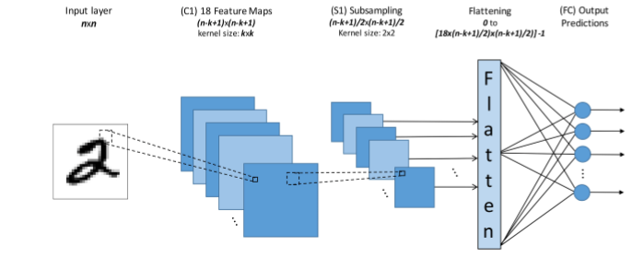
N-MNIST Digit Recognition (1)
N-MNIST is event-based version of MNIST dataset
Supervised learning approach
Cannot use standard backpropagation
Train unsupervised feature-extractor SNN as in previous study
Train supervised classifier SNN
Train ANN and convert to SNN
97.77% accuracy reported
Stromatias E, Soto M, Serrano-Gotarredona T and Linares-Barranco B. An event-driven classifier for spiking neural networks fed with synthetic or dynamic vision sensor data. Front. Neurosci; 2017.
Orchard G, Jayawant A, Cohen GK and Thakor N. Converting static image datasets to spiking neuromorphic datasets using saccades. Front. Neurosci; 2015
Notes:
Accuracy competes with CNNs on standard dataset
Latency issue

Slide 11
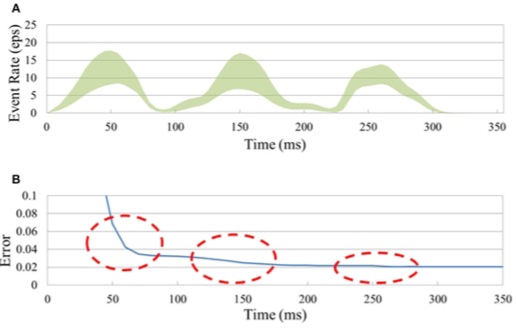
N-MNIST Digit Recognition (2)
Entire network trained with supervised learning
Utilise backpropagation on membrane potential
Assume membrane potential is differentiable
Weights and Threshold Voltage learnt for each LIF neuron
98.66% accuracy reported
Lee JH, Delbruck T and Pfeiffer M. Training deep spiking neural networks using backpropagation. Front. NeuroSci; 2016

Slide 12

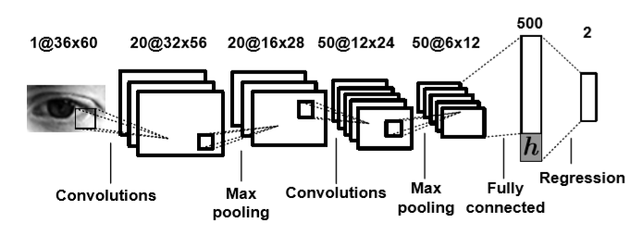
Going Forward
Map pixels directly to gaze position (or pupil position)
Has been done with ANNs on frames
Very slow!
Will require supervised (and/or unsupervised) learning for mapping
Utilise SNN on DVS data for ‘instantaneous’ gaze-tracking?
Baluja S, Pomerleau D. Non-Intrusive Gaze Tracking Using Artificial Neural Networks. Carnegie Mellon University, Pittsburgh, PA; 1994
George A, Routray A. Real-time eye gaze direction classification using convolutional neural network. 2016 International Conference on Signal Processing and Communications (SPCOM) : IEEE; Jun 2016

